Slide 1


Slide 2

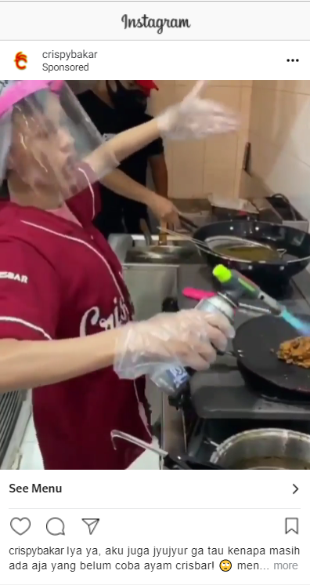
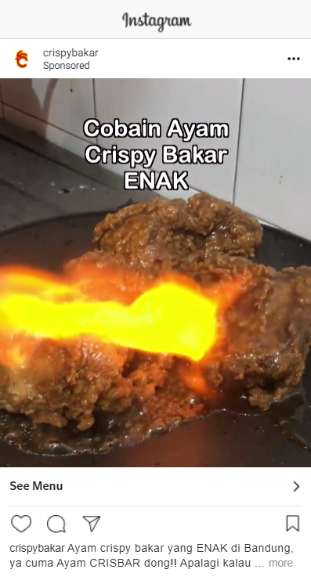
PROSPECTING CRISBAR CAMPAIGN
Lookalike 0-2%
CPR : Rp 119
Amount Spent : 1,861,231
Lookalike 0-2%
CPR : Rp 138
Amount Spent : 512,822
Lookalike 2-4%
CPR : Rp 118
Amount Spent : 197,752
Lookalike 2-4%
CPR : Rp 120
Amount Spent : 911,277
ALWI CRISBAR
ANGKY CRISBAR
RESULT : STILL RUNNING ON AUGUST
RESULT : STILL RUNNING ON AUGUST

Slide 3
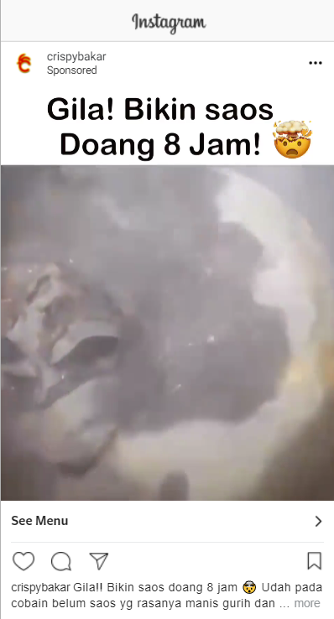
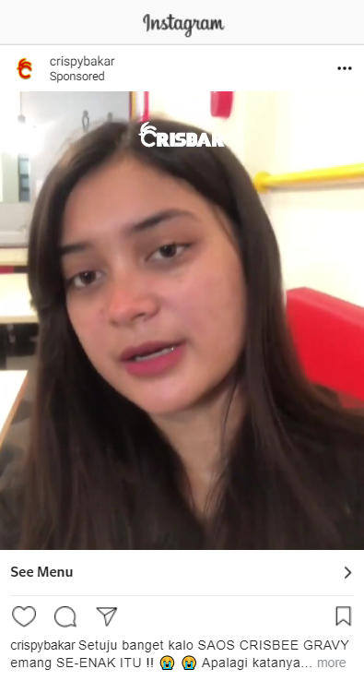
PROSPECTING CRISBEE CAMPAIGN
Lookalike 0-2%
CPR : Rp 102
Amount Spent : 2,220,605
Lookalike 0-2%
CPR : Rp 108
Amount Spent : 1,951
Lookalike 2-4%
CPR : Rp 98
Amount Spent : 944,735
Lookalike 2-4%
CPR : Rp 312
Amount Spent : 3,535
DKB CRISBEE
CRISBEE LUNET
RESULT : STILL RUNNING ON AUGUST
RESULT : TAKE OUT ON AUGUST
SUGGEST :

Slide 4
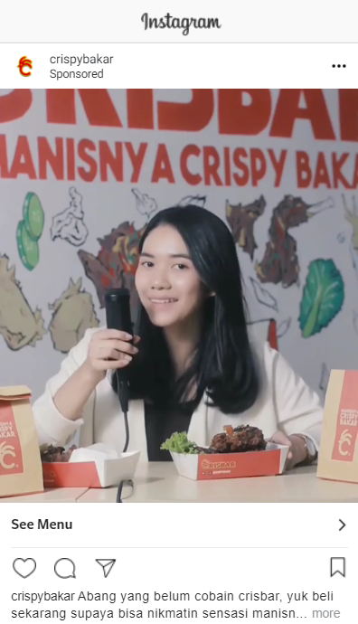
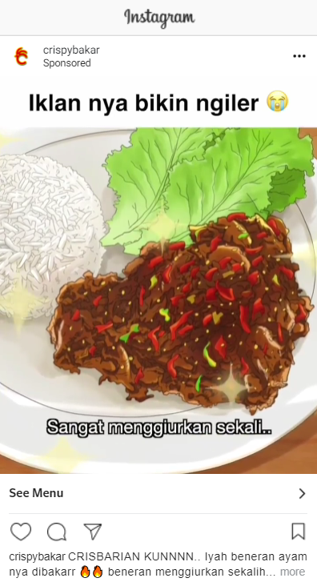
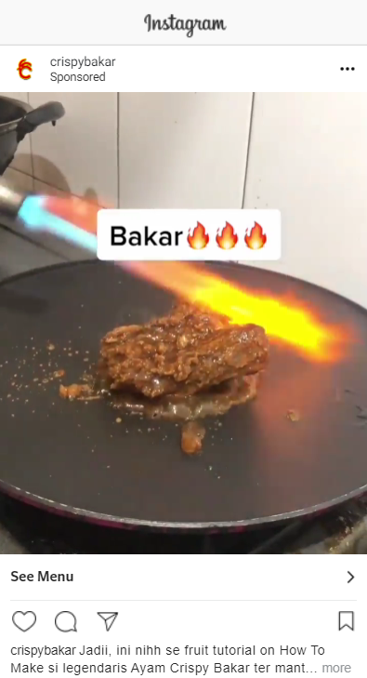
REENGAGEMENT CRISBAR CAMPAIGN
IG & FB CPR : Rp 209
Amount Spent : 151,815
Re-engagement 50% CPR : Rp
Amount Spent :
Re-engagement 75-90% CPR : Rp 212
Amount Spent : 135,260
IG & FB CPR : Rp 200
Amount Spent : 128,94
Re-engagement 50% CPR : Rp
Amount Spent :
Re-engagement 75-90% CPR : Rp 212
Amount Spent : 135,260
IG & FB CPR : Rp 180
Amount Spent : 969,868
Re-engagement 50% CPR : Rp 188
Amount Spent : 1,130,411
Re-engagement 75-90% CPR : Rp 198
Amount Spent : 678,396
ASMR Ivo
ANIME
TIKTOK TUTORIAL
RESULT : STILL RUNNING ON AUGUST
RESULT : TAKE OUT ON AUGUST
RESULT : STILL RUNNING ON AUGUST

Slide 5
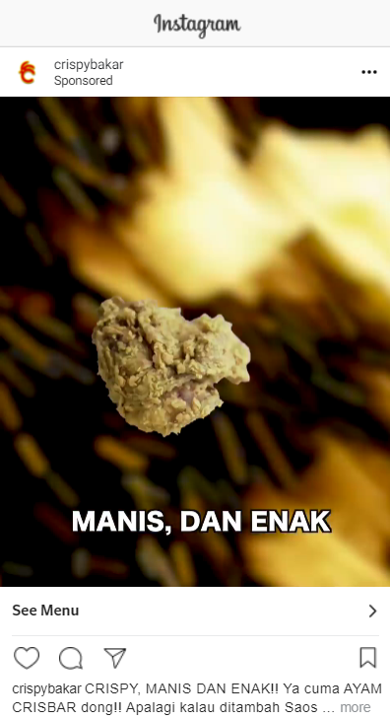
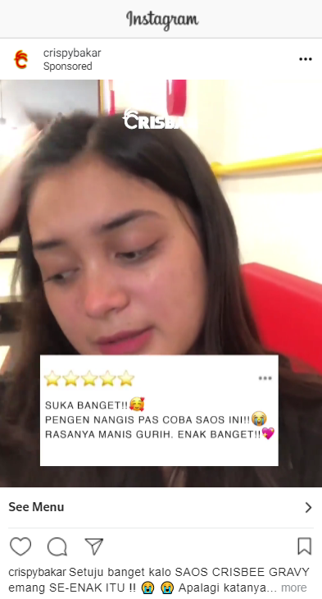
REENGAGEMENT CRISBEE CAMPAIGN
IG & FB CPR : Rp 424
Amount Spent : 179,692
Re-engagement 50% CPR : Rp 298
Amount Spent : 195,115
Re-engagement 75-90% CPR : Rp 281
Amount Spent : 190,642
IG & FB CPR : Rp 307
Amount Spent : 779,578
Re-engagement 50% CPR : Rp 305
Amount Spent : 960,672
Re-engagement 75-90% CPR : Rp 291
Amount Spent : 665,574
CRISBEE GARANSI
CRISBEE LUNET
RESULT : TAKE OUT ON AUGUST
SUGGEST :
RESULT : STILL RUNNING ON AUGUST

Slide 6
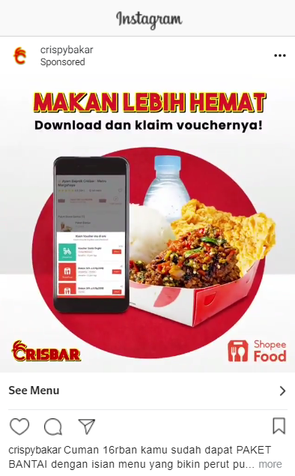
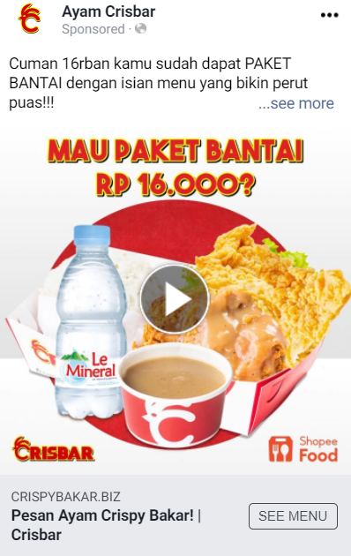
RETARGETING CRISBAR & CRISBEE CAMPAIGN
SHOPEEFOOD CRISBAR
SHOPEEFOOD CRISBEE
Database + Pixel CPR : Rp 518
Amount Spent : 1,483,046
Database + Pixel CPR : Rp 572
Amount Spent : 1,486,993
RESULT : STILL RUNNING ON AUGUST
RESULT : STILL RUNNING ON AUGUST

